Slide 1

Predictive Analysis of Medical Insurance Payment Durations in South Africa: A Case of LA Health
By
Yolisa Velebayi
Student number: 3339298
Email: yvelebayi@gmail.com
Cell: 0637087161
Supervisor: Dr Johan Breytenbach

Slide 2








AGENDA
Business Question and Research Objectives
Business Problem and Project Outcomes
Literature Review
Research Methodology & Workflow
Phases of Research Project
Research Intelligence
Research Analytics
Research Insights
Notes:
Important: add notes here below EACH SLIDE giving a FULL explanation of the slide

Slide 3
Business question and research objectives
Primary Question:
What determines the time frame for processing private medical insurance payments in South Africa?
Additional Questions:
How reliable are payment-duration predictions using claim and financial data?
Are payment times influenced by PMB status, contract status, or medical plan?
Objectives:
Identify the factors influencing claim payment speed
Develop a predictive model for payment duration
Provide actionable insights to improve claims processing
Inform how private insurance may adapt under the National Health Insurance (NHI) framework

Slide 4
Introduction to business problem
Problem:
Claim payment delays are inconsistent and unpredictable. These delays affect the financial stability of healthcare providers, especially smaller ones, and strain both insurers and patients. On-time payments are vital for maintaining provider trust and operational efficiency.
Context:
With the implementation of NHI on the horizon, private insurers must demonstrate efficient claims handling. Timeliness in claims processing will be a key performance indicator in the integrated health system.
Business Need:
LA Health must understand and address payment delays to improve its operations and ensure readiness for integration with the future NHI system.

Slide 5
Literature review / existing solutions
Administrative Delays: Caused by missing documents and manual processing. Solutions include automation and digital transformation.
Provider Contracting: Contracted providers tend to receive payments faster due to streamlined processes.
Regulatory Gaps: The industry lacks standardization in claims processing; improved transparency is recommended.
Patient Experience: Delays undermine trust and impose financial stress.
NHI Transition: Inefficiencies in the current system should inform the design of future universal health coverage models.

Slide 6
Research methodology
Sourcing Data: Acquired 50,000 invoice records from LA Health, containing payment timelines, patient demographics, provider details, and financial metrics.
Pre-processing Data: Removed duplicates and outliers; handled missing values using mean imputation and “Unknown” labels; one-hot encoded categorical variables.
Describing Data Variables: Created a target variable, Payment_Duration, and analyzed key features such as Total Cashflow, Turnover, Age, PMB status, and Contract status.
Training a Model: Developed five predictive models: Linear Regression, Decision Tree, Gradient Boosting, Lasso, and Random Forest (best-performing model).
Testing a Model: Used a 70/30 train-test split; evaluated models using MSE, RMSE, MAE, and R²; Random Forest achieved the highest accuracy (R² = 0.189).
Interpretation of Findings: Delays were longer for PMB and non-contracted claims. Financial and administrative variables were key predictors.
Discussion: The model moderately predicted payment durations and offered insights that can streamline
processing and inform NHI policy readiness.

Slide 7
Data: the data that I used explained
Initial dataset contained approximately 50,000 invoice records.
After preprocessing (removing duplicates, handling missing values, and outliers), 18,967 cleaned records remained.
Data included patient demographics (age, gender), provider details (contract status, specialty), and claim characteristics (PMB status, service centre).
Key financial features: Total Cashflow, Turnover, and Medical Aid Outstanding.
The target variable was Payment_Duration, calculated as Latest Capture Date – Earliest Capture Date

Slide 8
Variables: important variables selected for further investigation
Target Variable:
Payment_Duration (days)
Key Predictors:
Total Cashflow
Total Turnover
Patient Age
Contract Status
PMB Status
Debtor Financial Standing
Medical Specialty
Other variables such as service centre, diagnosis code, and medical aid option had less influence.

Slide 9
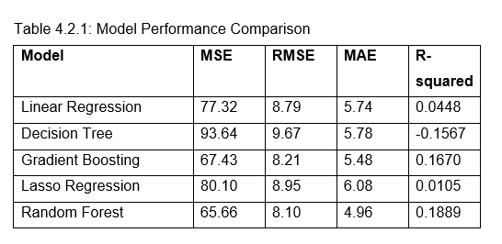
Model training and testing
Model Comparison:
Random Forest: Best (MAE=4.96, R²=0.189)
Gradient Boosting: Second-best
Linear & Lasso: Low predictive power
Decision Tree: Overfitting with negative R²

Slide 10
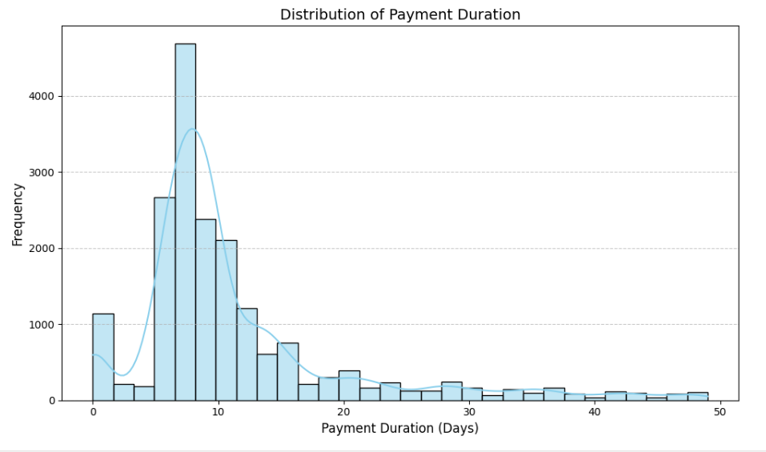
Visualization / BI / “Intelligent views of data”
Most transactions fall between 5 and 10 days, with a big peak showing that day 8 is when payment is most often made. Payments posted further beyond the first 10 days decline slowly, ending up in a long line that stretches to outlier situations where transactions took over 50 days

Slide 11
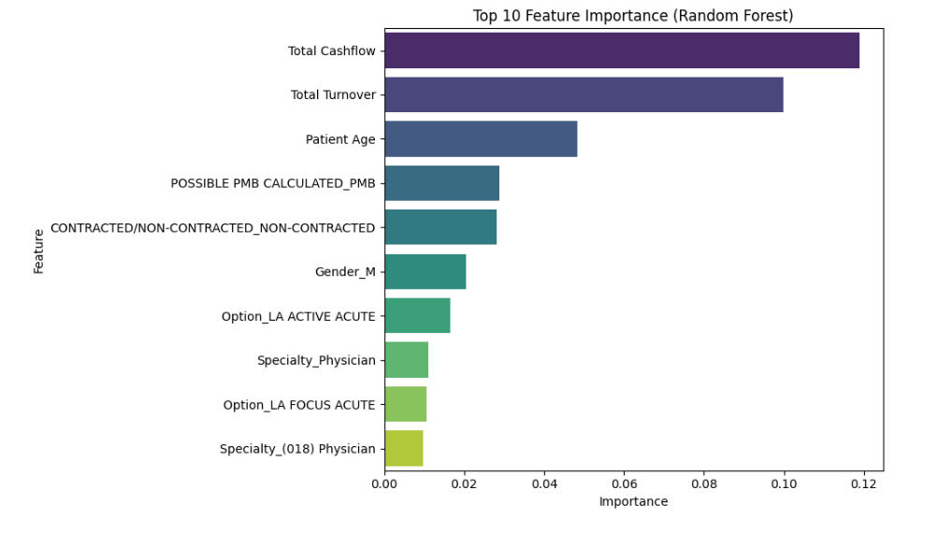
Top factors include financial variables and administrative status

Slide 12
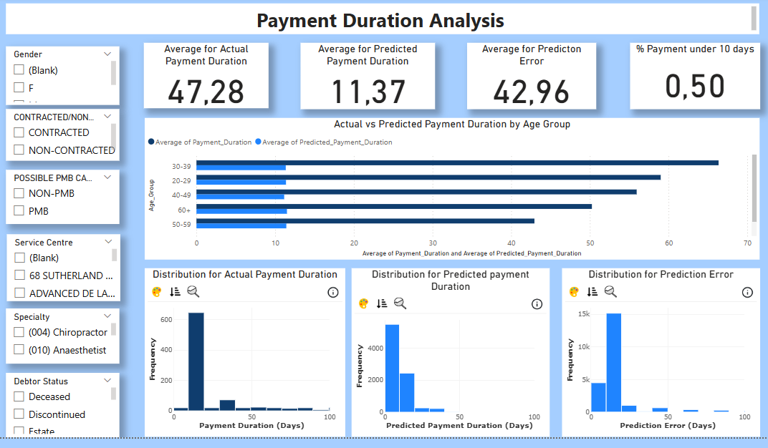
The dashboard reveals a significant gap between actual and predicted payment durations: 47.28 days vs. 11.37 days, highlighting the impact of outliers and the importance of high-quality data for reliable modelling.

Slide 13
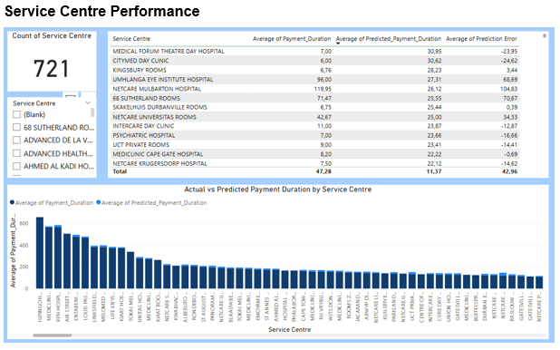
Payment delays varied widely across 721 service centres, with the model underestimating delays for outliers and overestimating for quick claims, indicating limited accuracy for extreme cases.

Slide 14
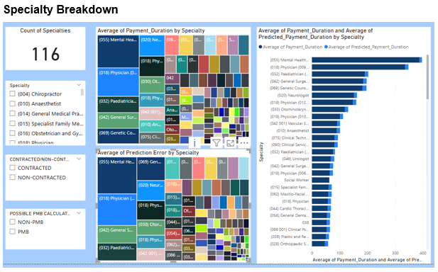
The model performed well for routine specialties but consistently underpredicted payment durations for complex fields like Mental Health and Paediatrics, where administrative complexity is higher.

Slide 15
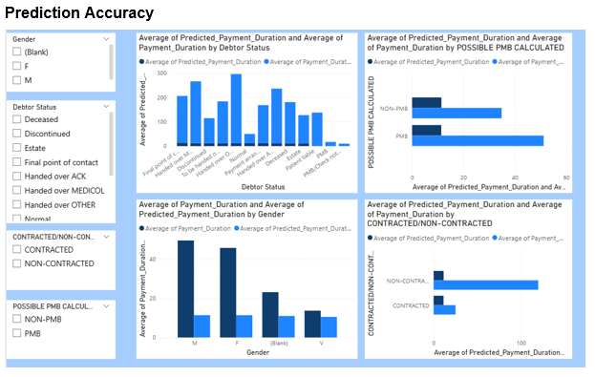
Accuracy varied significantly across categories, with major underpredictions observed for claims involving poor debtor status, PMB cases, males, and non-contracted providers.

Slide 16
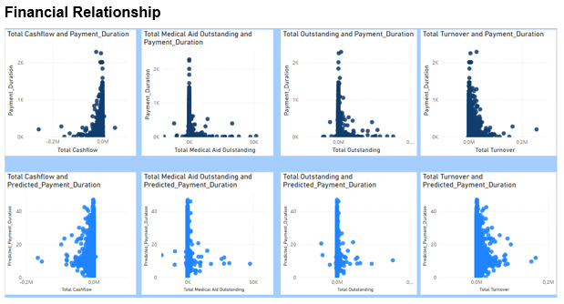
While the model captured general trends, it underestimated delays for high-value claims, suggesting that financial magnitude impacts processing time more than the model accounts for.

Slide 17
Interpretation of results
Overall Trend: Most claims are paid promptly, but some experience significant delays.
PMB and Non-Contracted Claims: These consistently show slower payment timelines.
Predictive Model: The model explained approximately 19% of the variation but underperformed on complex or outlier cases.
Driving Factors: Financial metrics and provider contract status were the strongest influencers.
Dashboard Insight: Visualizations confirmed that the model systematically underestimated delays for PMB and non-contracted claims, highlighting the need to incorporate more detailed administrative features for improved prediction accuracy.

Slide 18
Research insights
Automating the handling of high-risk and PMB claims can help reduce delays and improve overall processing efficiency.
Expanding partnerships with healthcare providers may streamline claims settlement, particularly for non-contracted providers who currently face longer delays.
The use of interactive dashboards enables real-time identification of operational bottlenecks and supports targeted process improvements.
Enhancing the quality and completeness of claims data is essential to improving the predictive accuracy of the model.
These insights can also inform broader policy efforts, supporting claims standardization and alignment with South Africa’s upcoming National Health Insurance (NHI) framework.

Slide 19
Conclusion
LA Health’s claims are mostly settled within two weeks, but variability remains
The Random Forest model outperformed others but captured only 19% of the variability
Financial and administrative attributes significantly impact payment timing
These insights can enhance claims efficiency and inform policy shifts under NHI

